Slide 1
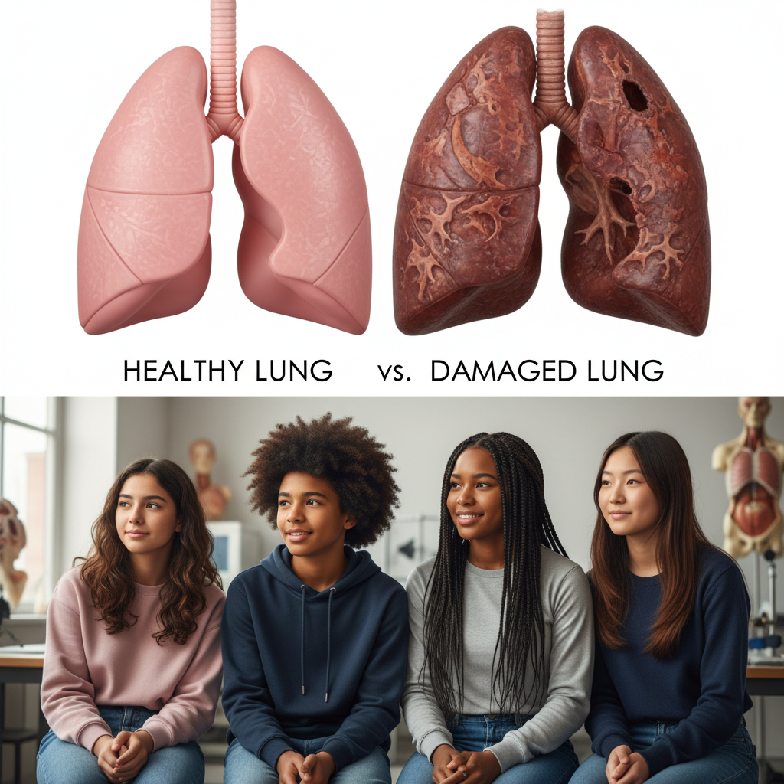
ModelIt!
Student Lesson
The Vaping Crisis: What's Really Happening to Your Lungs?
Modeling Chemical Damage to the Respiratory System
NGSS: HS-LS1-2
9th Grade — Level 1: Foundations
1/9

Slide 2
What You Will Learn Today
Learning Goals
* Model how chemical exposure from vaping damages lung cells over time
* Explain the relationship between nicotine concentration, inflammation, and lung cell health
* Predict how chronic vaping leads to progressive respiratory system damage
* Analyze why short-term effects may not reflect long-term consequences of vaping
Key Vocabulary
Inflammation Response
The body's immune reaction to injury or irritation — sending white blood cells and fluids to the damaged area, causing swelling, redness, and reduced function
Epithelial Cells
The thin layer of cells lining the lungs' airways and alveoli that facilitate gas exchange and protect against pathogens
Chronic Exposure
Repeated contact with a harmful substance over weeks, months, or years — causing cumulative damage that may not be immediately apparent
Alveolar Damage
Destruction or impairment of the tiny air sacs in the lungs where oxygen and carbon dioxide are exchanged with the bloodstream
2/9

Slide 3

The Big Question
If vaping is "just water vapor," why are teenagers ending up in the hospital?
Modeling Chemical Damage to the Respiratory System. Today we'll build a MODEL to discover the answer!
3/9

Slide 4

Today We Will Build a Model!
A model helps us understand complex systems!
1. LOCATE
Identify the COMPONENTS (parts) of the system
2. ESTABLISH
Connect them with RELATIONSHIPS (+ or -)
3. VISUALIZE
Build your model in ModelIt!
4. EVALUATE
Run SIMULATIONS to test scenarios
5. REVISE
Improve your model based on evidence
4/9

Slide 5
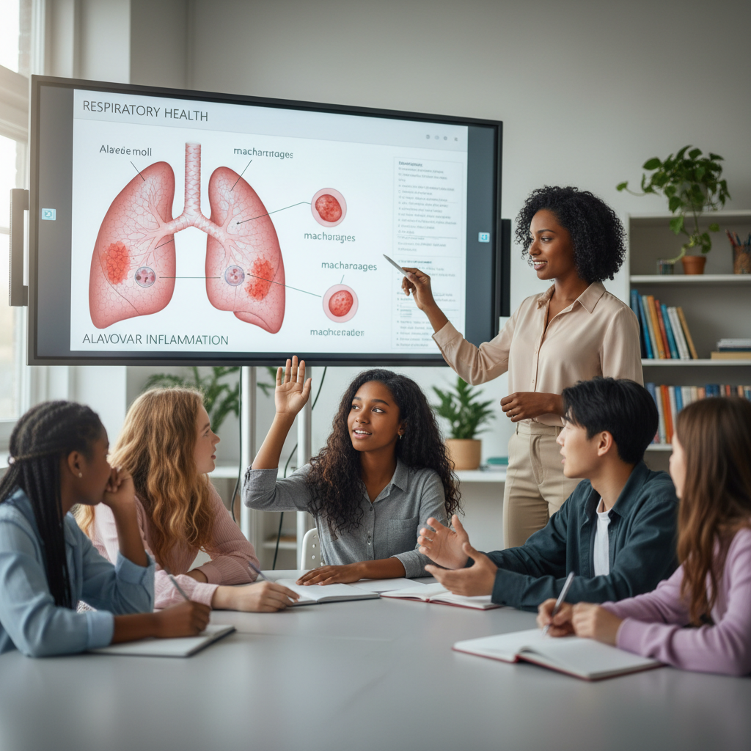
Activity 1: Sort the Components
Sort these components into EXTERNAL (inputs from outside) and INTERNAL (inside the system):
Your Components:
* Nicotine Concentration
* Chemical Exposure Duration
* Lung Cell Health
* Inflammation Response
Think: Which components can we control? Which happen on their own?
5/9

Slide 6
Activity 2: Connect with Arrows
Draw arrows to show HOW components affect each other:
(+) POSITIVE Relationship
When one goes UP, the other goes UP too
(-) NEGATIVE Relationship
When one goes UP, the other goes DOWN
Think About It:
If Nicotine Concentration is high and Chemical Exposure Duration increases over months, what happens to the cycle between Inflammation Response and Lung Cell Health? Can the lungs recover?
6/9

Slide 7
Activity 3: Run the Simulation!
Test these scenarios in ModelIt!
Occasional Use
Set Nicotine Concentration low and Chemical Exposure Duration short — observe Lung Cell Health
Daily Heavy Use
Set Nicotine Concentration high and Chemical Exposure Duration long — observe the damage cascade
Quit After 6 Months
Set high exposure for a period, then reduce Nicotine Concentration to zero — can the lungs recover?
Watch the activity graphs change!
[ModelIt Platform Screenshot - Simulation Results Graph]
7/9

Slide 8
What Did We Discover?
Our Model Showed Us:
* Nicotine and vaping chemicals directly damage epithelial cells, reducing their ability to protect the lungs and facilitate gas exchange
* Chronic inflammation creates a destructive cycle — the immune response meant to heal actually causes additional tissue damage over time
* The damage is cumulative and not always reversible — some lung cell damage becomes permanent after prolonged exposure
* Short-term effects are mild enough to ignore, which is why many vapers don't realize the damage until it's significant
Answer: Vaping is NOT just water vapor — it delivers nicotine, heavy metals, and volatile organic compounds directly into the lungs. These chemicals damage the epithelial cells lining the airways and trigger chronic inflammation. The inflammation meant to protect the lungs actually accelerates tissue destruction in a vicious cycle. Over time, this cascade reduces lung function, and some damage becomes permanent.
8/9

Slide 9

STEM Challenge: Design a Vaping Impact Public Health Campaign
YOUR ENGINEERING MISSION
Create a science-based public health campaign that uses data from your model to show teens the real biological impact of vaping on lung tissue.
The Challenge:
The local health department has noticed a 40% increase in teen vaping and wants to launch a campaign that goes beyond 'just say no.' They need scientifically accurate materials that show WHAT actually happens inside the lungs. Your team has been hired to create the campaign using your model data.
Think Like an Engineer:
* What biological evidence from your model is most compelling for convincing teens?
* How can you present cumulative damage data in a way that resonates with 14-15 year olds?
* What makes science-based messaging more effective than fear-based messaging?
REAL CAREER CONNECTION: Pulmonologists are physicians who specialize in respiratory diseases and lung health. They diagnose and treat conditions from asthma to EVALI (E-cigarette/Vaping-Associated Lung Injury), earning $300,000–$500,000/year. Respiratory therapists who work directly with patients earn $55,000–$75,000/year. The skills you're using TODAY are the same ones they use on the job!
9/9

